Slide 1
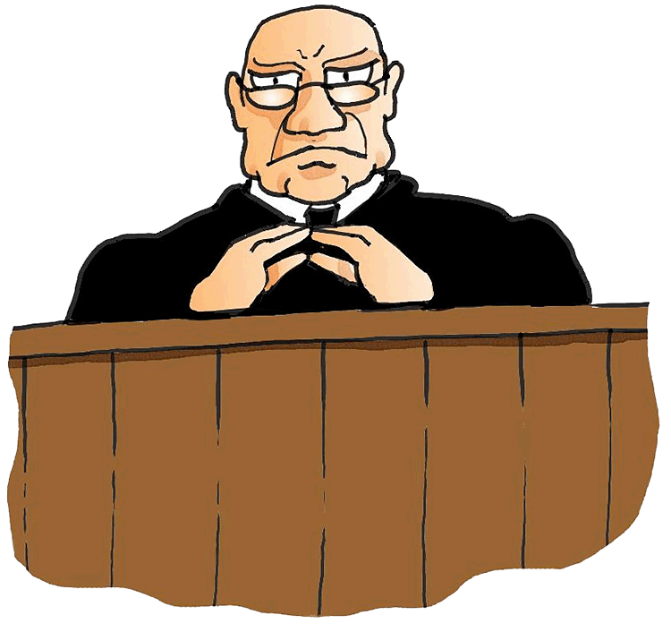
The Discovery End Date Dance
NJAJ Meadowlands 2015
Shelley L. Stangler Esq.

Slide 2
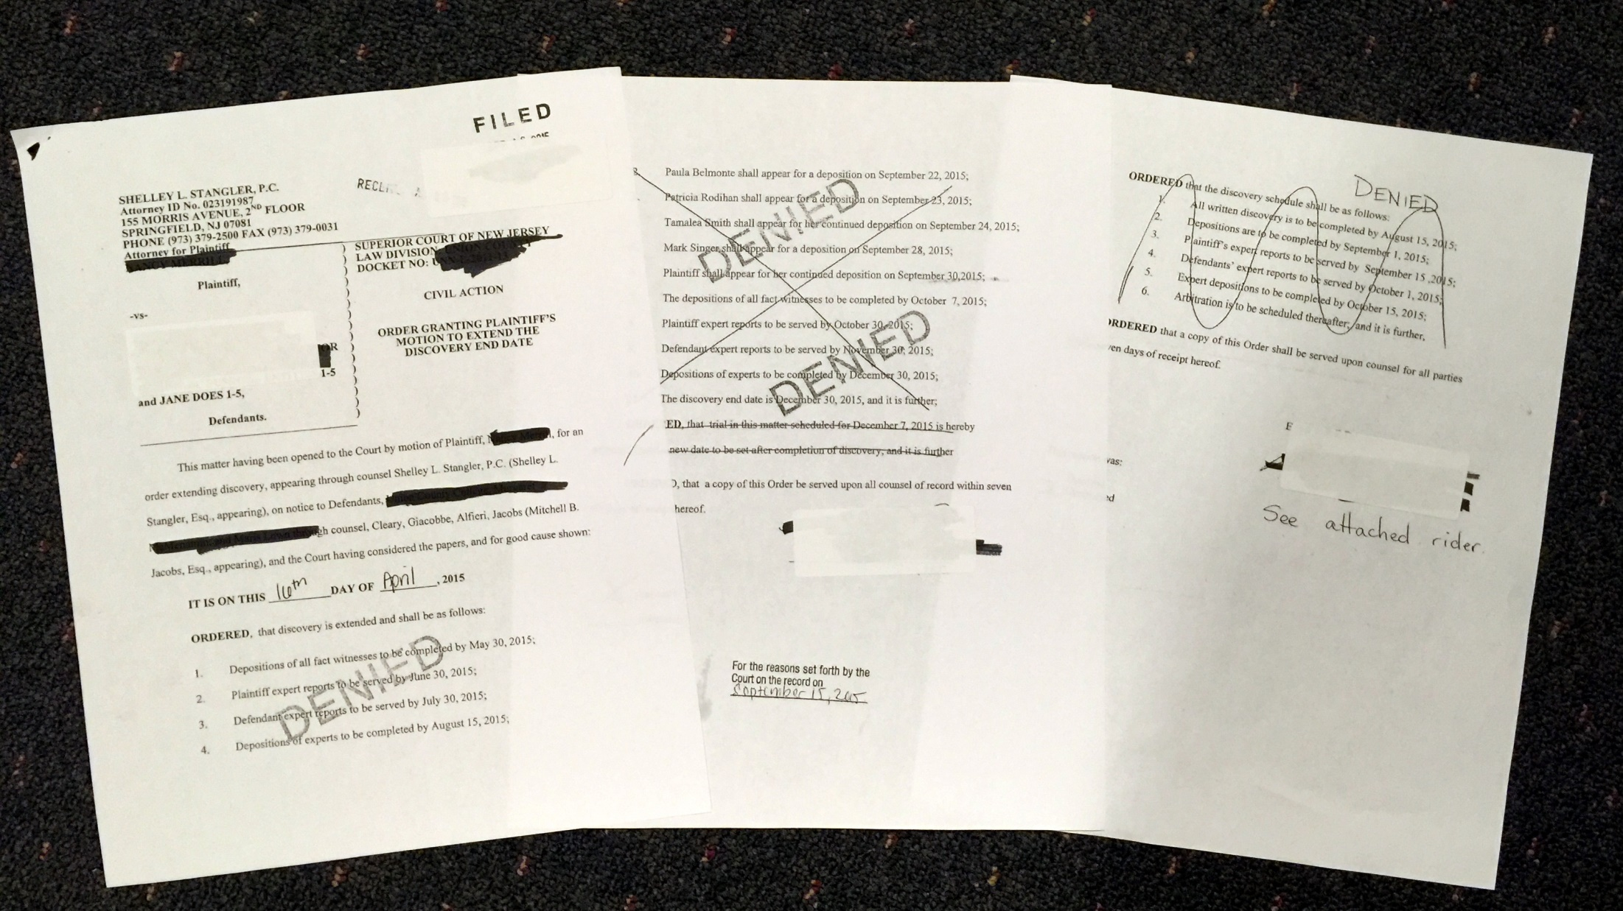
DENIED!
2

Slide 3
DENIED!
3

Slide 4
GOOD CAUSE VS. EXCEPTIONAL CIRCUMSTANCES
Rule 4:24-1(c)
Extension motion to be “made returnable prior to the conclusion of the applicable discovery period. The Court may, for good cause shown, enter an order extending discovery.
Absent exceptional circumstances no extension of the discovery period may be permitted after an arbitration or trial date is fixed.
4

Slide 5
WHAT DOES THIS MEAN?
Scheduling arbitration or trial during discovery destroys the Good Cause Standard
Best to prepare to argue exceptional circumstances
5

Slide 6
RELEVANT CASES
Tucci v. Tropicana Casino & Resort, Inc., 364 N.J. Super. 48 (App. Div. 2003)
Ponden v. Ponden 374 N.J. Super. 1 (App. Div 2004), certif. den. 183 N.J. 212 (2005)
6

Slide 7
EXCEPTIONAL CIRCUMSTANCES
Rivers v. LSC Partnership
378 N.J. Super 68 (App. Div.) certif. den., 185 N.J. 296 (2005)
Vitti v. Brown,
359 N.J. Super. 40 (Law. Div. 2003)
Reed- Montijo v. Rodriguez
2012 WL 4448760 (App. Div. Sept. 27, 2012)
7

Slide 8
THE FOUR PART VITTI TEST
Why discovery was not completed and counsel’s diligence
The additional discovery sought is essential
Reason for counsel’s failure to request an extension prior to the end of discovery
Circumstances were beyond the control of plaintiff or counsel
8

Slide 9
PRACTICE POINTERS
Can the extension be accomplished without affecting arbitration/trial
Please file your motions on time- DED diary or software
If you file before the DED but motion returnable thereafter:
Adams v. Nahas, 2007 WL 1484144 (App. Div. May 23, 2007)
9

Slide 10
PRACTICE POINTERS 2
File for Reconsideration
Ask for a Case Management Conference
Write a substantive certification with exhibits
Write a brief
10

Slide 11
OTHER HELPFUL CASES
Shula v. Estabrook, 385 N.J. Super. 91 (App. Div. 2006)
A-1 Property Management, LLC v. Bergenwood Commons Assoc.
2007 WL 1296474 (App Div. May 4, 2007)
Fager v. Okechukwu, M.D. 2008 WL 398810 (App. Div. Feb 15, 2008)
11

Slide 12
WHAT ABOUT AGREEMENT WITH YOUR ADVERSARY?
NO ENFORCEMENT MECHANISM
12

Slide 13
ONGOING MEDICAL TREATMENT = EXCEPTIONAL CIRCUMSTANCES
Vitti v. Brown 359 N.J. Super. 40 (Law. Div. 2003)
Pullaro v. Pier Village
2011 WL 722266 (App. Div. March 3, 2011)
Battle v. Jersey Central Power & Light
2008 WL 2388381 (App. Div. June 13, 2008)
13

Slide 14
DENIAL OF DISCOVERY
Court cites to “days of discovery”
Failure to provide expert reports
Bender v. Adelson, 187 N.J. 411 (2006)
Huszar v. Grate Bay Hotel & Casino, 375 N.J. Super. 463 (App. Div. 2005)
Zadigan v. Cole, 369 N.J. Super. 123 (Law. Div. 2004)
14

Slide 15
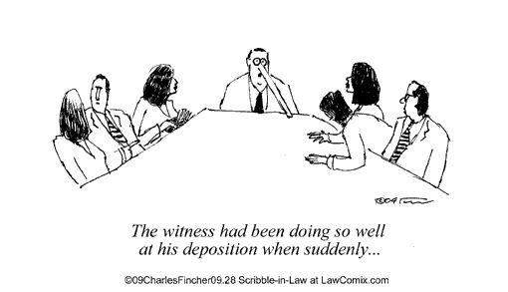
Questions?

