Slide 1
Your Child’s Civil Rights What every parent needs to know
NJAJ - Meadowlands
Shelley L. STANGLER
DECEMBER 9, 2021

Slide 2
Constitutional rights in school – Key Concepts
Code of student conduct
Special or “unique characteristics of the school setting”
School greater latitude /lower standard than general public
Need to maintain order, safety, discipline, security
Trivial/de minimus vs Substantive

Slide 3
Due Process
14th Amendment: “no state shall deprive any person of life, liberty or property without due Process of law”
Chambers v. Sch. Dist.of Phila Bd. of Educ. 587 F.3d 1767 (3d Cir. 2009)
Hill v. Borough of Kutztown 455 F.3d 225 (3d Cir. 2006)

Slide 4
Due Process
Forbids arbitrary deprivation of property or liberty right
Right to free public education is a protected property right
Fundamentally fair process required
Procedures must provide due process

Slide 5
Due Process in the school setting
Goss v. Lopez 419 U.S. 565 (1975)
The 10 day rule – discipline
Short term suspension
Suspension without a hearing
Entitled to notice of charges and opportunity for student to present their version only

Slide 6
Goss v. Lopez
No right to counsel
No right to confront and cross examine witnesses
No right to call student’s own witnesses
Minimum safeguards
No right to have parents present
No right to hearing for “trivial period” ≤ 10 = de minimus
Immediate interview permitted

Slide 7
Short Suspension Trivial
Taylor v. Metuchen Public School Dist.
2019 WL 1418124 (D.N.J. 3/28/19)
1-2 days suspension trivial deprivation
No loss of educational opportunity

Slide 8
Due Process in the school setting
Code of student conduct controls
N.J.A.C. 6A:16-7.1
Ability to prescribe conduct broad
Includes conduct away from school
Establish safe, secure and disciplined school environment conducive to learning
Discipline can be contested with full due process rights

Slide 9
The Better Case
LITIGATION OVER VAGUE CODE OF CONDUCT –
Flaherty v. Keystone Oaks School District 247 F. Supp. 2d 698 (W.D. Pa. 2003)
Discipline vs Academics - college setting
Litigation over failure to follow code of conduct

Slide 10
Due Process in the school setting
Discipline over 10 days:
Lower standard in general
Arbitrary and capricious standard
Full due process rights still limited
Palmer v. Merluzzi
868 F.2d 90 (3d Cir. 1989)

Slide 11
Due Process in the school setting
Matthews v. Eldridge 424 U.S. 319 (1976)
Third Circuit Balancing Test:
Severity of the deprivation
Capacity for erroneous ruling
Value of additional safeguards

Slide 12
Due Process – Right to counsel
The “Right to Counsel” is a procedural safeguard under Miranda
Not a substantive right in education context
No right to counsel
Higher education as well
Hearings can be presented with advocate
K.A. Exrel. J.A. v. Abington Heights School District 28 F. Supp. 3d 356 (M.D. Pa. 2014)
Furey v. Temple University 884 F. Supp. 2d 223 (E.D. Pa. 2012)

Slide 13
Due Process – Mental Health Examination
School has authority to order exam prior to return to school
Requiring mental health evaluation is not a deprivation of an educational benefit
Any deprivation is trivial or de minimus
School has authority to proscribe conduct even if it interferes with free speech
Astacio v. East Brunswick H.S. 2019 WL 3843090 (D.N.J. 8/15/19)

Slide 14
Due Process by NJ Statute
Suspension/expulsion
N.J.S.A. 18A:37-2 Broad standards – “disobedience or defiance of authority” to be determined by the Board of Education
N.J.A.C. 16:7.2, 7.3, 7.4 Short and long terms suspensions, expulsions ten day rule

Slide 15
“Trivial” discipline
Giangrasso v. Kittatinny Regional High School 865 F. Supp. 1130 (D.N.J. 1994)
One day suspension de minimus and attorney sanctioned for frivolous action
Psych requirement prior to re-entry into school affirmed

Slide 16
Due Process by NJ Statute
Appeal to the Commissioner of Education
Procedures N.J.A.C./ 6A:3-1.1 et. seq.
All controversies and disputes under the education laws title 18A or rules of the State Board of Education
Student Discipline
Charter School
Residency
Tenure/Teacher claims
Appeals NJSIAA (NJ State Interscholastic Athletic Assoc)
Transportation

Slide 17
Due Process by NJ Statute
90 DAYS FROM NOTICE OF FINAL DECISION N.J.A.C. 6A:32-7.7
“At all stages of the appeal process, the parent or adult student shall be afforded a full and fair opportunity to present evidence relevant to the issue.”

Slide 18
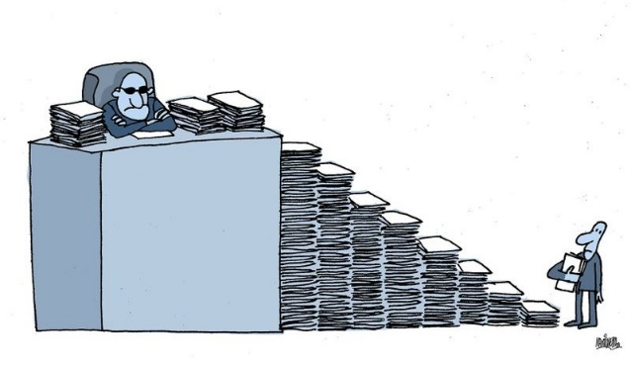
Due Process by N.J. Statute
Petition to the Bureau of Controversies and Disputes
Emergent Application N.J.A.C. 6A:3-1.6
Injunctive Relief Standard Crowe v. DeGioia 90 N.J. 126 (1982)

Slide 19
Litigation in the O.A.L.
RIGHT OF APPEAL TO APPELLATE DIVISION N.J.A.C. 6A-4
SPECIAL EDUCATION – IDEA – NJAC 6A:14

Slide 20
First Amendment in the School Setting
First Amendment applies to students, however:
Right to maintain order, safety
Does the speech impact order, safety
Restrictions justified where material and substantive disruption of the work and discipline of the school
Must analyze based on special characteristics of school environment
Rights of students not co-extensive with similar rights outside school

Slide 21
First Amendment in the School Setting
PURE SPEECH IS PROTECTED:
Tinker v. Des Moines Ind. Community School Dist. 393 U.S. 733 (1969) (Armband)
West Va. State Bd. of Ed. V. Barnette 319 U.S. 624 (1943) (Salute flag)

Slide 22
Harassment, Bullying, Intimidation not protected
Dunkley v. Bd. of Educ. of the Greater Egg Harbor Regional School District 216 F. Supp. 3d 485 (D.N.J. 2016)
Conduct determined to constitute HIB can be regulated off-campus
NJ requires school to take action. The Anti-Bullying Bill of Rights Act N.J.S.A. 18A:37-13.2 et. seq.

Slide 23
Speech contrary to legitimate policy objectives is not protected
Bethel School District v. Fraser, 478 U.S. 675 (1986) (Vulgar and offensive speech in school)
Morse v. Frederick, 551 U.S. 393 (2007) (Banner promoting illegal drug use prohibited)
Hazelwood School District v. Kuhlmeier 484 U.S. 260 (1988) (Speech appears to have school imprimatur)

Slide 24
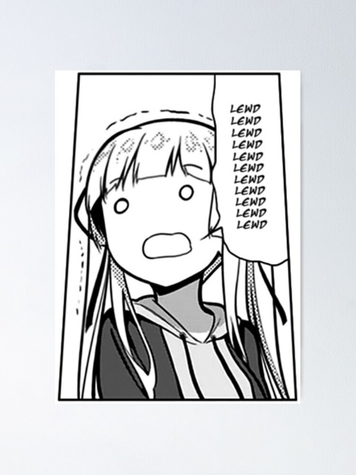
On Campus Speech
Lewd, vulgar, offensive speech can be regulated Bethel School District v. Fraser
Student code of conduct “disdisobedience” and “defiance” under NJAC
Promotion of illegal drug use Morse v. Frederick
Speech that appears to have imprimatur of school (school newspaper) Hazelwood v. Kuhlmeier
Speech deemed disruptive to school environment
Tinker v. Des Moines Indp. Community Sch. Dist.
Layschock v. Hermitage Schl. Dist. 650 F.3d 205 (3d Cir. 2011)

Slide 25
Off Campus Speech
Speech that does not impact school order and discipline protected, even if offensive
J.S. ex rel. Snyder v. Blue Mountain School Dist. 650 F.3d 915 (3d Cir. 2011) Hewlette- Bullard v. Pocono Mountain School District 522 F. Supp. 3d 78 (M.D. Pa. 2021) Mahoney Area School Dist. v. Levy 141 S. Ct. 2038 (June 23, 2021) J.S. by M.D. v. Manheim Twp. School Dist. 2021 WL 5350219 (Pa. Sup. Ct 2021)

Slide 26
First Amendment – Parent Rights
Due Process liberty interest in making decisions regarding upbringing of child
These interests are not implicated in school disicipline – parent not prevented from raising child as they see fit
J.S. ex rel. Snyder v. Blue Mountain School Dist. 650 F.3d 915 (3d Cir. 2011)

Slide 27
Fourth Amendment in the School Setting
Fourth Amendment search & seizure proscriptions apply in school
Limited by necessity to maintain order, safety, security, conduct
Unique characteristics of school environment
Balancing test- reasonableness standard

Slide 28
Fourth Amendment in the School Setting
Probable cause does not apply – lesser standard of “reasonableness”
Privacy interests subordinate to need to maintain order in schools
Diminished expectation of privacy
No warrant needed
Greater degree of supervision and control permitted in school

Slide 29
Fourth Amendment in the School Setting
New Jersey v. T.L.O 105 S.Ct. 733 (1985) (Search of purse permitted)
Vernonia School District 47 v. Acton 115 S. Ct. 2386 (1995) (Random urinalysis for athletics permitted)
Joye v. Hunterdon Central Regional H.S. Bd. of Ed. 176 N.J. 568 (2003) (Random drug testing for extracurricular activites permitted)
Gutin v. Washington Twp. Bd. of Educ. 467 F. Supp. 2d 414 (D.N.J. 2006) (Probable cause is not the standard for search-standard is “reasonableness”-balancing test)

Slide 30
Summary
STUDENTS DO NOT LEAVE THEIR CONSTITUTIONAL RIGHTS AT THE SCHOOL HOUSE DOOR
HOWEVER, THE UNIQUE CHARACTER OF THE SCHOOL ENVIRONMNET HAS MODIFIED THOSE PROTECTIONS:
Less expectation of privacy
Greater regulation of speech
Rejection of Claims that are de minimus/Trivial- not lose educational opportunity
Minimal due process rights unless abrogated by statute
LOOK FOR ARBITRARY & CAPRICIOUS ACTION
REAL DAMAGES

Slide 31
Thank You
Website www.stanglerlaw.com
Twitter @shelleystanglerlaw
Email shelley@stanglerlaw.com
Phone 973-379-2500

