Slide 1
ICLE Evaluating Civil Rights Claims: Plaintiff’s Perspective
Shelley L. STANGLER
SEPTEMBER 30, 2020

Slide 2
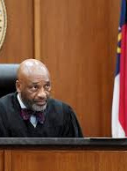
Damages
Most civil rights cases involve substantive briefing on dismissal. Damages should be commensurate with legal time, effort and costs involved in pursuing these cases.

Slide 3
Notice of Claim
90 Days
One year motion to file a late notice
False arrest – 90 days from arrest
Malicious prosecution – 90 days from date of dismissal
Minor – 90 days from date of majority
Federal & discrimination claims – LAD, NJCRA, §1983 not necessary
Allege all claims
Include all names – not required, but good practice to name parties individually

Slide 4
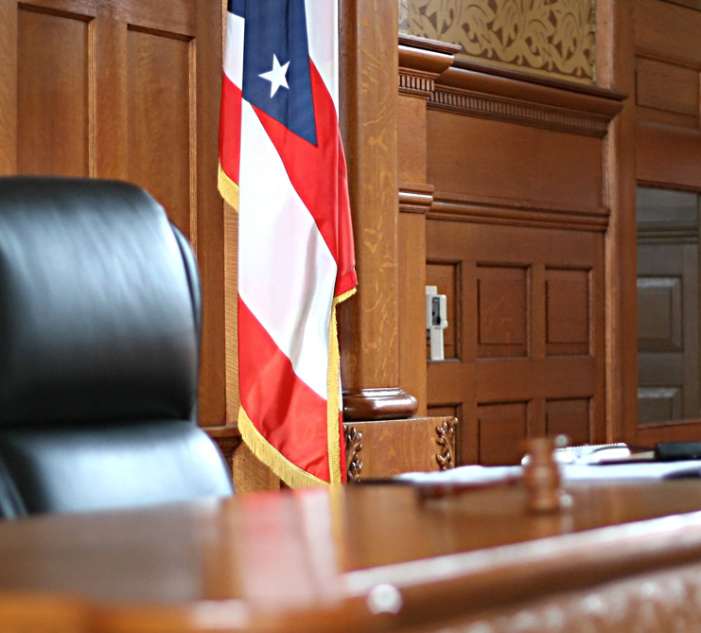
Statute of Limitations
Two years

Slide 5
Prison Litigation Reform Act of 1995 – 42 U.S.C. § 1997e(a)
Exhaustion of Administrative Remedies
Restrictions of right to sue
No specifics on what procedure is necessary or remedies
Must file IA or SID complaint/grievances
Must exhaust all appeals
Includes excessive force and all claims – not just conditions of confinement Porter v. Nussle, 534 U.S. 516 (2002)- Ginsberg
Is the grievance process made “available” – not if there is no result or follow up Ross v. Blake, 136 S.Ct. 1850 (June 6, 2016)- Kagan

Slide 6
Probable Cause – Arrest, Searches & Prosecution
Reasonable belief of crime defines a low standard
Dismissal of charges not good enough
Grand Jury indictment is prima facie probable cause
Qualified/good faith immunity
Photo array
Third party complaint
Judge signs a warrant or finds probable cause

Slide 7
Under Color of State Law
Must be acting as a police officer, not on private business
Barna v. City of Perth Amboy, 42 F.3d 809 (3d Cir. 1994)
Fagan “Causal Conduit” Doctrine - may permit suit against public entity
Fagan v. City of Vineland, 22 F.3d 1283 (3d Cir. 1994)

Slide 8
Immunities on their face
Pursuits
Failure to provide police protection
Suicides - vulnerability
Title 59

Slide 9
Investigation Purposes Only – Don’t make promises
Retainer – 1983 retainer – review issue of attorney’s fees if court awards - Use standard personal injury retainer

Slide 10
Pleadings
Who to sue – Entity vs Individuals Individual vs official capacity suits
11th Amendment Immunity – state is not a “person” under §1983
Individual capacity suits permitted

Slide 11
Pleadings
Public entity – Monell vs Dept. of Social Services of NYC, 436 U.S. 658 (1978)
Policymakers
Supervisors
Individual actors

Slide 12
What amendment is involved
4th – Unlawful Seizures
14th – Due process
8th – Cruel and unusual punishment
1st – Retaliation, political, access to courts
What is the right: Life, liberty, property, equal protection, religion & assembly

Slide 13
Pleading Standards
Federal vs State:
“Plausiblity” vs Suggestion”

Slide 14
Federal: Rule 12(b)(6)
Plausible – Enough facts to suggest liability can be found
Court identifies conclusory allegations
No heightened standard of pleading
Must assume truthfulness of facts
Discovery required for a civil rights plaintiff
Amendment as of right

Slide 15
State: Rule 4:6-2(e)
Suggestion of a potential claim
Discovery may provide a basis of relief
Indulgent reading of complaint
“Under no set of facts”

Slide 16
Everything is conclusory
Factual content must be detailed
Group pleadings inconsistent: “all the defendants beat me up”

Slide 17
Examples of a conclusory statement
“Failure to train and supervise”
“Pattern of use of excessive force or improper arrest”
“Defendants knew or should have known”
“Failure to enact or enforce policy”
“There is a known history of suicides at the jail”
“The defendants failed to investigate complaints”

Slide 18
Examples of a better pleading
“Defendants failed to supervise at 15 min intervals in accordance with express policy requiring close or constant watch”
“Over the past five years there have been ten documented suicides”
Hanging by a sheet despite finding suicide watch
Hanging by clothes when policy forbids clothes in the cell
Suicide after screaming for help and officers refused to assist
“Failure to enact or enforce policy”
“Examples of lawsuits brought for excessive force include…which indicate a repetitive pattern of assaults without remediation”

Slide 19
Practice pointer – Putting meat on the bones
Find notice by doing research
Find lawsuits
Find policies on-line
Find accreditation reports on jails, police departments
Policies: AG, Police training commission, Nat Assoc, Police chiefs
Experts

Slide 20
Practice pointer – Putting meat on the bones
Look to other cases you’ve handled
Get records in advance
NJ Star Ledger: Survey of police misconduct
NJ Star Ledger: Survey of jail suicides

Slide 21
Structure of the complaint
Separate the claims
Separate the parties
Group pleading frowned upon
Separate the liability claims against each individual defendant

Slide 22
Claims
1983 – Public entity
1983 – Policymaker individual liability
1983 – Supervisory individual liability
1983 – Individual officers
Set forth the applicable amendments and rights in issue
1983 – Failure to intervene

Slide 23
Claims
1983 – Conspiracy
1983 – Equal protection
1985 – Conspiracy based on racial animus
1981 – Contract claim
State created danger
1988 – Legal fees

Slide 24
NJCRA – Article 1, §1
Modeled after §1983
Same safeguards and rights as federal law
Broader protections – court is to undertake analysis of state rights
NJCRA vindicates states substantive rights – not procedural

Slide 25
Other claims
ADA, Title VII, Title IX, Section 504
State law claims
Ministerial duties / undertaking a duty

Slide 26
Motion to dismiss
Conclusory-insufficient fact allegations
Cannot prove monell/supervisory liability cases – scarcity of facts

Slide 27
1. Policy 2. Custom 3. Practice
TEACH THE COURT

Slide 28
Teach the court
Policy failures sufficient – failure to enact / implement
Do not need direct involvement
Knowledge and acquiescence sufficient
Failure to train and supervise
Deliberate indifference

Slide 29
Supervisory liability – Two theories
Policy, practice and custom
Participate in violation, directed others to violate or knew about subordinate’s misconduct
Supervisory liability not abrogated by lqbal

Slide 30
Negligence / negligent training & supervision
Separate and independent tort – stand alone tort
Failure of supervision is not subject to discretionary immunity

Slide 31
Title 59 immunities
Failure to provide police protection 59: 5-4
Failure to enforce law 59: 3-3
Failure to adopt or enforce a law 59: 2-4, 59: 3-5
Discretionary immunity 59: 3-2 (employee), 59: 2-3 (entity)

Slide 32
Title 59 immunities
Failure to diagnose or treat 59: 6-4, 6-5
Pursuit immunity 59: 5-2
Inmate on inmate violence 59: 6-7, 59: 5-2
Failure to make arrest, 59: 5-4
No immunity for willful misconduct

Slide 33
Ministerial duties
Violation of actual policies and SOP
Undertaking a duty

Slide 34
Qualified immunity – Good faith immunity
Was the constitutional right violated?
Was the violation established and officer knows conduct unlawful?
Objective not subjective standard

Slide 35
Immunity
For plaintiff
Against plaintiff
…fact sensitive / for jury
…more restrictive rulings – broad general propositions insufficient

Slide 36
State v. Federal – Which venue?
State court
Federal court
Comfort level
Federal pleading standards extremely onerous
Judge handles these cases regularly
Judges have greater flexibility
State laws on discovery more restrictive

Slide 37
Thank You
Website www.stanglerlaw.com
Twitter @shelleystanglerlaw
Email shelley@stanglerlaw.com
Phone 973-379-2500

